Slide 1
Welcome to Battle of the Bots
Joint event BY GW Robotics & ieee

Slide 2
Competition Rules
Tournament Style Competition
Match Duration: 5 minutes, with potential extensions for ties
Scoring:
1 point for pushing the opponent's robot out
1 point for flipping or immobilizing the opponent for 10+ seconds.
First team to score 3 points wins.
Sudden Death: If tied at the end, next point wins
1-minute pause for fixes: if bot is pushed, flipped, or immobilized

Slide 3
Robot Build Rules
Robot Design: No sharp or damaging components (flipping allowed).
Dimensions: Max 8x8 inches (W/L) and 7 inches in height.
Requirements: Remote-controlled, 4 wheels, and workshop guidelines.

Slide 4
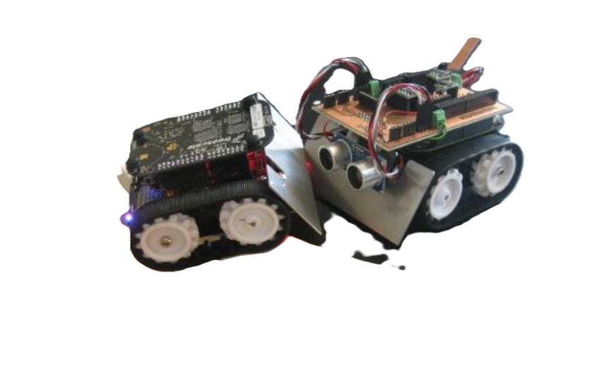
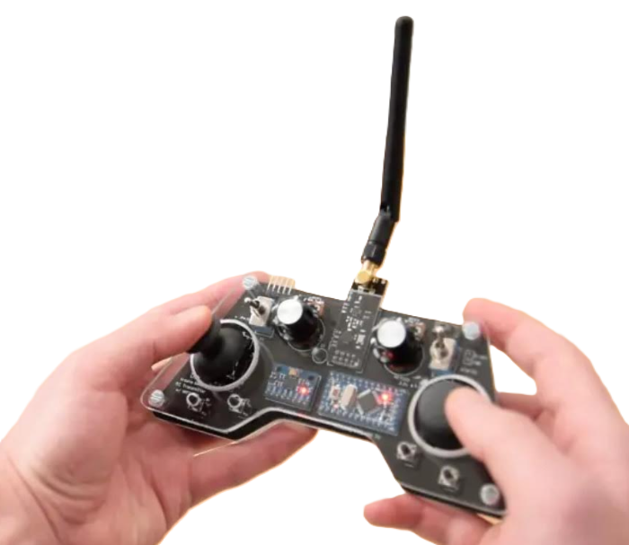
Base Robot Components
RC: Arduino Nano(microcontroller) + 2 Joysticks + RF module.
Robot: Arduino Nano(microcontroller) + 2 DC motors + 4 wheels + Distance sensor + RF module.

Slide 5
Workshops & Component Pickup
Workshop Attendance: Required to pick up components and check-in
Components: Available only at workshops and must be returned after the event.
Workshops Topics:
Arduino Nano Basics + RF Transmission
Sensor Integration + Motor Control with Arduino
CAD for Chassis Design

Slide 6
Event Timeline
Workshop 1: Tuesday, Nov 19, 7:00 - 8:00 PM
Workshop 2: Thursday, Nov 21, 5:30 - 6:30 PM
Workshop 3: Thursday, Dec 5, 5:30 - 6:30 PM
Final Event: Saturday, Dec 7, 1:00 - 3:00 PM

Slide 7
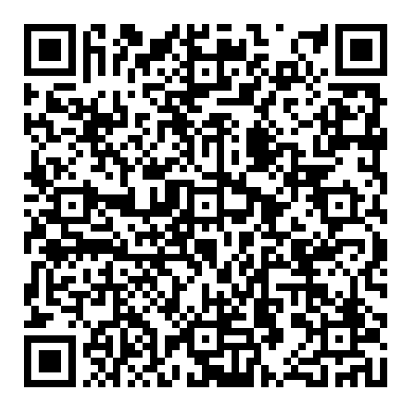
Team Formation
Team Size: Maximum of 4 people per team.
If you signed up individually, we’ll pair you with others in the same situation to ensure everyone has a team
Team Signup:

